Slide 1
Placement Data Analysis
Presented by Group 2
Aryan Kumar – MBA/06/068
Akshita Singh Bais – MBA/06/071
Muskan Garg – MBA/06/087
Pratik Sankhe – MBA/06/100
Rashmi Ranjan – MBA/06/096

Slide 2




Analyzing data based on the gender, background domain and work ex.
Finding the regression and correlation of various factors of percentage and status of placement.
Hypothesis testing to find whether the mean of MBA is 62% or not & Clustering

Slide 3
Background Analysis
Male : Female | 1.83:1
In both the genders majority of the students belong to commerce and management background

Slide 4
Work Experience Analysis
Finding: The difference of work-ex widens the most among Science & Technology graduates
 | Male | Female
Commerce & Management | 32.61% | 28.3%
Medical & Others | 40% | 33.33%
Science & Technology | 47.62% | 29.41%

Slide 5
Specialization Analysis
Males prefer Marketing & Finance as their specialization while females are almost equally inclined towards both the specialization
Number of placed candidates placed are very high in Marketing & Finance as compared to marketing & HR.
On the similar lines, number of unplaced candidates less in Marketing and finance as compared to marketing & HR.

Slide 6
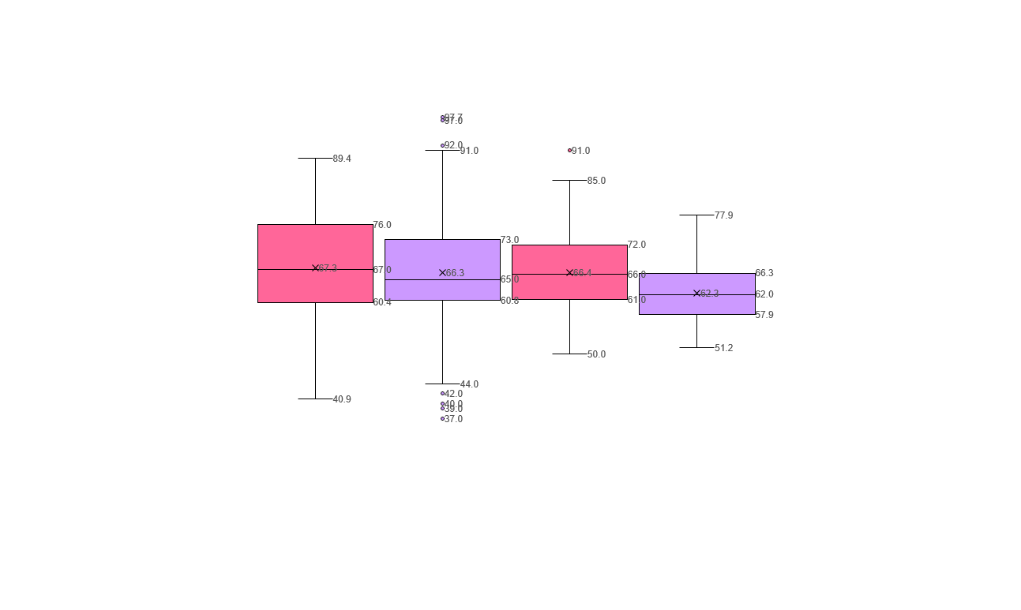
Descriptive Analysis
SSC%
HSC%
Degree%
MBA%

Slide 7
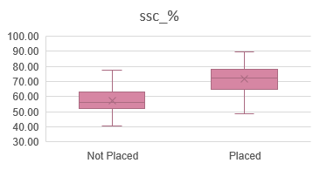
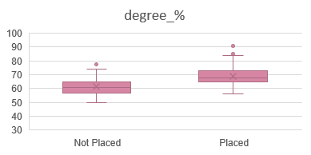
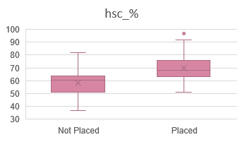
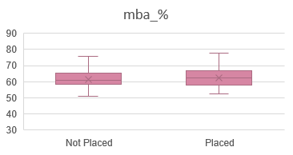
Importance of Percentage
MBA % is the least affecting percentage for placements & SSC % is the most affecting percentage for placements

Slide 8
Regression
S.E.=5.35
S.E.=5.47
S.E.=5.39

Slide 9
Correlation
 | SSC% | HSC% | Degree% | MBA%
SSC% | 1
HSC% | 0.51 | 1
Degree% | 0.54 | 0.43 | 1
MBA% | 0.38 | 0.35 | 0.40 | 1
SSC% and degree% have moderately positively correlation. Therefore, a good score in SSC% indicates a good score in degree % as well.
SSC% and HSC% are least correlated. Therefore, SSC% does not affect the MBA%.

Slide 10
Regression
Correlation
Variable | Marketing & Finance | Marketing & HR
 | P value | P value
SSC % | 1.29E-08 | 0.000275
HSC % | 0.047181 | 0.001104
degree % | 0.29782 | 0.001819
MBA % | 0.20602 | 3.29E-06
Variable | Marketing & Finance | Marketing & HR
 | Correlation with status of placement | Correlation with status of placement
SSC % | 0.60 | 0.58
HSC % | 0.41 | 0.52
degree % | 0.40 | 0.50
MBA % | 0.17 | -0.07
P-value of SSC% in Marketing & Finance is lowest, so it is most significant variable there. In case of Marketing & HR most significant variable is MBA%
The correlation of SSC% is highest with status of placement in both case and it is a moderate positive relation. Only MBA% has negative correlation in case of Marketing & HR

Slide 11
Hypothesis Testing
Null hypothesis | Mean of MBA% = 62.28
Alternate Hypothesis | Mean of MBA is not = 62.28
Level of significance | 5%
Mean of sample | 62.28
Standard deviation of sample | 5.83
T statistic | 0.72
The value of statistic doesn’t lies in the rejection region.
Therefore, we fail to reject this null hypothesis

Slide 12
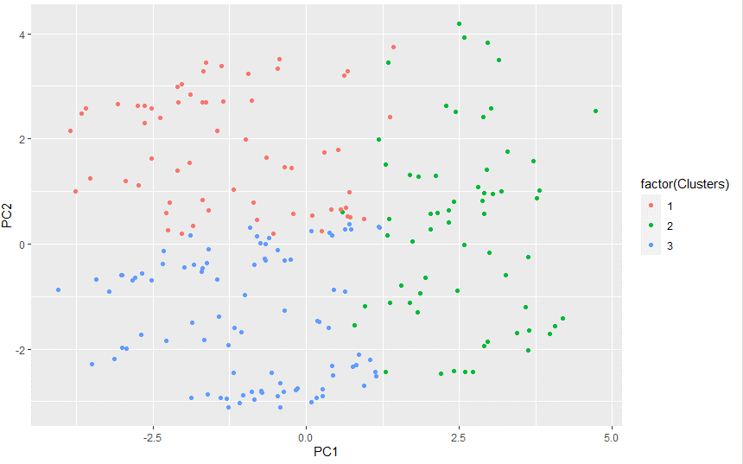
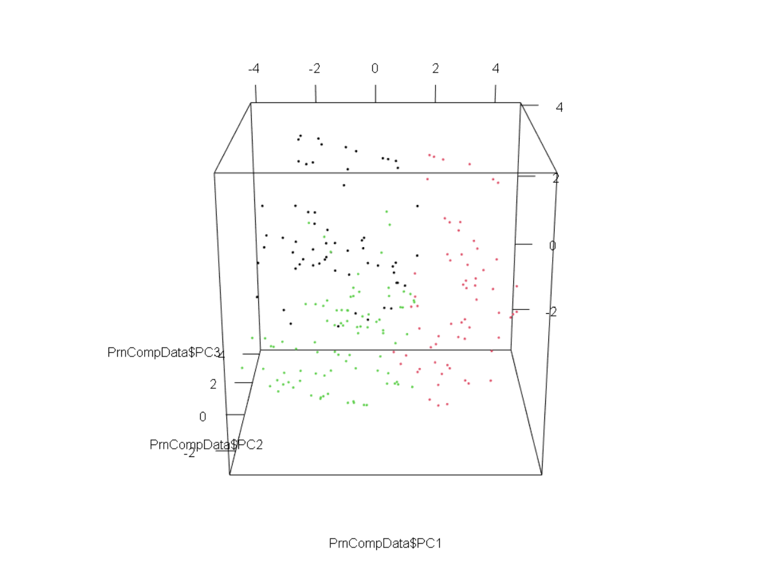
CLUSTER VISUALIZATION
2D Cluster Representation
3D Cluster Representation
Cluster Definition:
Cluster1 | Cluster2 | Clister3
Good placed | Not Placed | Highly Placed
Workex | specializationMarketing & Human Resources | specializationMarketing & Finance
Degree_domain:Science & Technology | No workex | Workex
hsc_streamScience | Degree_domain:Medical & Others | Degree_domain:Commerce & Management
High Male | hsc_streamArts | hsc_streamCommerce
 | High Female | High Male

Slide 13

Anomaly
Cluster 3
Oh!! They got placed
West Coastal | Pune | Ahmednagar |
Expected: Placed
Reality: Unplaced
MBA : Marketing & Finance
Work Exp: Yes
Degree: Commerce & Management
HSC Stream: Commerce
%SSC: 63.3
What!! Unplaced

Slide 14


Anomaly
Cluster 2 students
West Coastal | Pune | Ahmednagar |
West Coastal | Pune | Ahmednagar |
Expected: Unplaced
Reality: Placed
Expected: Unplaced
Reality: Placed
MBA : Marketing & HR
Work Exp: No
Degree: Commerce & Management
HSC Stream: Commerce
%SSC: 59
MBA : Marketing & HR
Work Exp: Yes
Degree: Medical &Others
HSC Stream: Arts
%SSC: 60

Slide 15




Recommendations
Approach more companies with Marketing + HR requirement
Design a pre-placement test and less focus on past academic records
Provide training to students on latest technologies that are flourishing in the market.
Ensure that companies give equal opportunities for Male & Female.
Representation of students from all specialization in placement committee

Slide 16
By Group 2
THANK YOU!

